Slide 1
Welcome to the Stikins PowerPoint presentation for PTA meetings.
You can edit any of the sections displayed as black text by clicking on that text.
We recommend replacing the school number on slide 6 with your own school number (if you have one).
You can also add in additional slides to include information specific to your school or PTA – including any particular fundraising projects that you may wish to put your commission earnings towards.
You should, of course, delete this slide when you have finished editing.

Slide 2
School Fundraising With Stikins Name Labels
PTA & School Fundraising That Is:
Rewarding – earn 30% commission when parents order name labels
Established – thousands of schools have joined the scheme since 2004
Easy – parents order from Stikins & commission is paid in November
Useful – Stikins’ stick on name labels encourage more parents to label school kit, which reduces lost property in school

Slide 3
How It Works
Schools sign up using the online Sign Up & Requests Form.
Stikins allocate each school with a unique fundraising number.
Schools earn 30% commission on every order that quotes their number.
Parents order directly from Stikins & Stikins record commission earnings.
(Schools can track their commission earnings via the Stikins website.)
Commission is paid out automatically in November by cheque.
The minimum payout is £10.
This requires just £34 worth of orders (no more than 4 orders)
and there is no maximum payout.

Slide 4
The School’s Role
Sign up and tell parents about Stikins name labels
and give them the school’s fundraising number.
Stikins provide free fundraising materials to help with this, including:
Parent Leaflets
Notice Board Posters
Digital E-Flyers
Vouchers For School Prizes
Free Personalised Samples For New Starters (Summer Term Only) (Various formats available from full names to anonymous initials)
The website also includes a Commission Booster Plan to help schools
get the most out of the scheme along with extra tips and advice.

Slide 5
Why Choose Stikins?
Stikins are stick on name labels for school uniform and kit,
including shoes and bags, P.E. kit, lunch boxes and water bottles, stationery and digital devices, and other personal items.
Each bright white label measures 30mm x 15mm and is personalised with a bold black font, which is easy to read for children of all ages.
Stikins are despatched same day by Royal Mail’s first class service.
There are millions in use with over 12,000 five star reviews from parents.
Stikins give parents a simple, quick, and budget-friendly way to label school kit, which boosts labelling in school and reduces lost property.

Slide 6
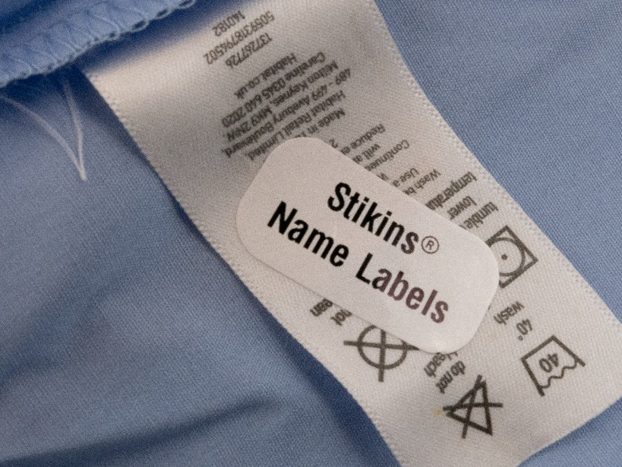
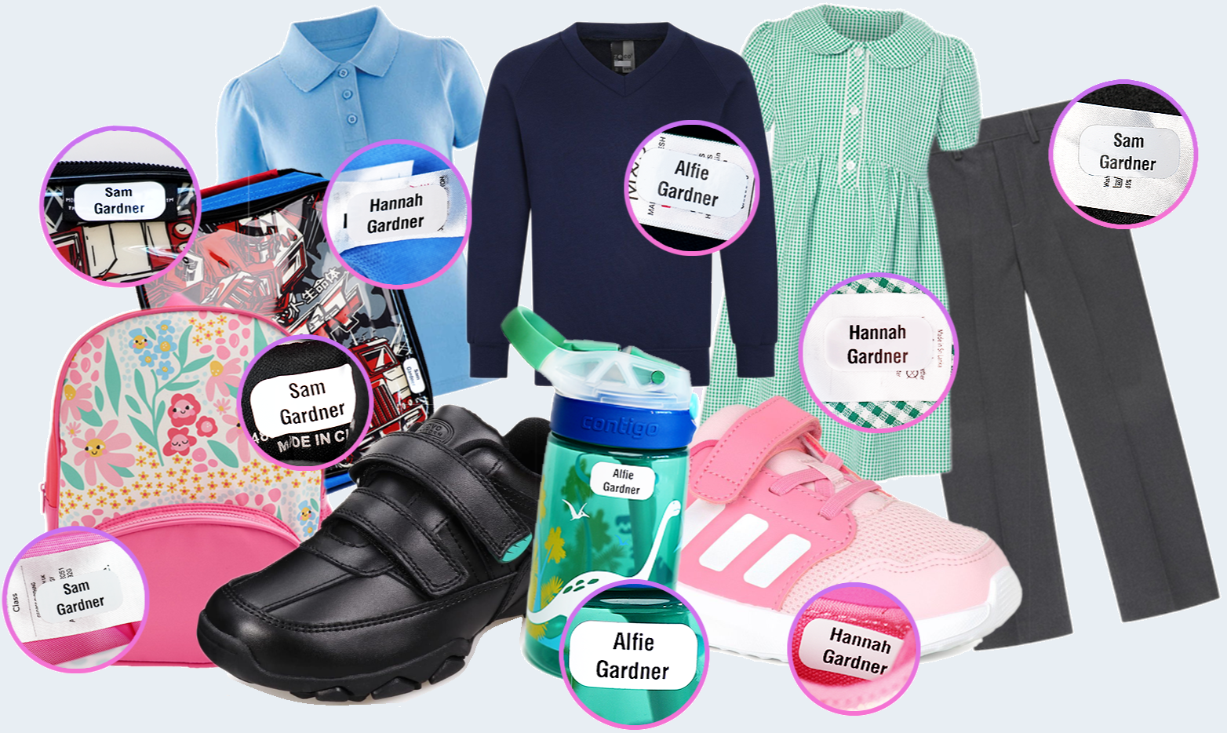
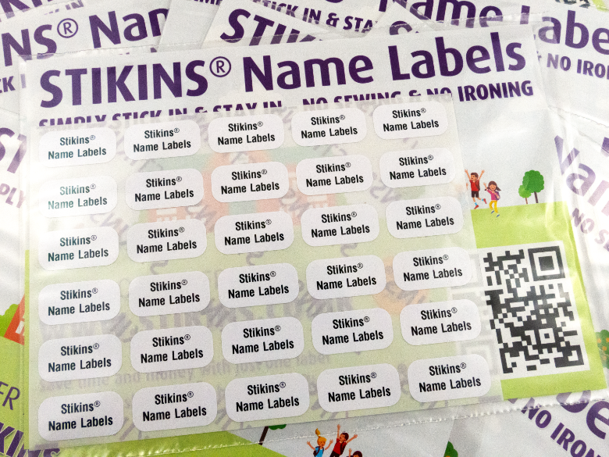
Stikins In Use

Slide 7
Reasons To Fundraise
With Stikins
Amazing 30% commission rate
Automatic commission payout once a year
Completely free to join and no ongoing costs
Encourages name labelling & reduces lost property
Free fundraising materials to boost your commission
Year round fundraising that requires minimal resources
Friendly support from a team with over 20 years’ experience

